Slide 1
C++ Programming
Jerry Lebowitz

Slide 2

Topics
Templates
Standard Template Library (STL)

Slide 3
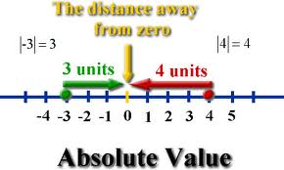
Absolute Value Function for Integers
// Objective - Find the absolute value of an int
#include <iostream>
using namespace std;
int findAbs(int myInt);
int main( void )
{
cout << findAbs (3) << endl;
cout << findAbs (-3) << endl;
}
int findAbs(int myInt)
{
return (myInt < 0 ? -myInt: myInt);
}
see example: template1.cpp

Slide 4

Absolute Value Function for Doubles
// Objective - Find the absolute value of an float
#include <iostream>
using namespace std;
double findAbs(double myDouble);
int main()
{
cout << findAbs (3.3) << endl;
cout << findAbs (-3.3) << endl;
}
double findAbs(double myDouble))
{
return (myDouble)< 0.0 ? –myDouble: myDouble));
}
see example: template2.cpp

Slide 5
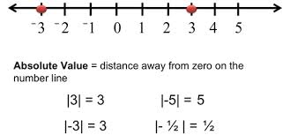
Absolute Value Function
A different absolute value function is needed for each data type
The absolute value function could be overloaded but multiple versions of the function must still be written
Not very efficient
Increases maintenance

Slide 6

Templates
Allows one to write one version of a function that can be used for all built-in data types and user-defined types
Allows one to define functions and classes that have data types as parameters
Function templates are not functions but are patterns or blueprints
Class templates are not C++ classes but are patterns or blueprints
Templates require less source code and less maintenance
Code has to be changed in only one place

Slide 7

Function Template Syntax
template <class typeParameter> // function template
typeParameter functionName(typeParameter identifier)
{
body of function
};
Keyword template is required
Keyword class actually means type (NOT C++ class)
typeParameter is the template argument
Represents any built-in or user data type (including C++ classes)
Templates should have prototypes

Slide 8
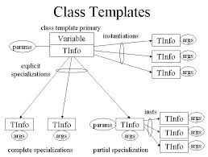
Function Templates
Code is not generated when the compiler encounters a template definition
Code generation occurs when the function is invoked since the data type is known at that time
This is called instantiating the function template
The function is instantiated once for each data type
Amount of memory is the same with and without templates
The argument passed to the function determines which function to instantiate or invoke

Slide 9
Template Example
template <class flexibleData> // template prototype
flexibleData findAbs(flexibleData n);
int main()
{
int int1 = 5;
int int2 = -6;
long long1 = 70000L;
double double1 = 9.95;
cout << "\nAbs(" << int1 << ")=" << findAbs(int1); // instantiate function
cout << "\nAbs(" << int2 << ")=" << findAbs(int2); // Abs(int)
cout << "\nAbs(" << long1 << ")=" << findAbs(long1); // Abs(long)
cout << "\nAbs(" << double1 << ")=" << findAbs(double1); // Abs(double)
}
template <class flexibleData> // template prefix
flexibleData findAbs(flexibleData n)
{
return (n < 0) ? -n : n;
} see example: template3.cpp

Slide 10
Another Template Example
template <class atype>
int find(atype* arrayName, atype value, int arraySize);
char charArray[ ] = {'A', 'B', 'C', 'D', 'E', 'F'}; // array
char myChar= 'E'; // value to find
int intArray[ ] = {1, 3, 5, 9, 11, 13};
int myInt = 6; // value to find
int main()
{
cout << "\n E in charArray: index=" << find(charArray, myChar, 6);
cout << "\n 6 in intArray: index=" << find(intArray, myInt, 6);
}
template <class atype>
int find(atype* array, atype value, int size)
{ for(int j=0; j<size; j++)
if(array[j]==value)
return j;
return -1;
} see example: template4.cpp

Slide 11
Parameters Must Match
int find(atype* arrayName, atype value, int arraySize);
char charArray[] = {'A', 'B', 'C', 'D', 'E', 'F'}; // array
char myChar= 'E'; // value to find
int intArray[] = {1, 3, 5, 9, 11, 13};
int myInt = 6; // value to find
long longArray[ ] = {1L, 3L, 5L, 9L, 11L, 13L};
long myLong = 11L; // value to find
double doubleArray[ ] = {1.0, 3.0, 5.0, 9.0, 11.0, 13.0};
double myDouble = 4.0; // value to find
void main(void)
{
cout << "\n E in charArray: index=" << find(charArray, myChar, 6);
// cout << "\n 6 in intArray: index=" << find(intArray, myLong, 6); // parameters don’t match
cout << "\n11 in longArray: index=" << find(longArray, myLong, 6);
// cout << "\n 4 in doubleArray: index=" << find(doubleArray, myInt, 6); // parameters don’t match
}
template <class atype>
int find(atype* array, atype value, int size)
{
for(int j=0; j<size; j++)
if(array[j]==value)
return j;
return -1;
} see example: template5.cpp

Slide 12
Function Template with Multiple Arguments
template <class atype, class btype>
btype find(atype* arrayName, atype value, btype arraySize);
int intArray[] = {1, 3, 5, 9, 11, 13};
int myInt = 6;
long longArray[] = {1L, 3L, 5L, 9L, 11L, 13L};
long myLong = 11L;
void main()
{
int intArraySize=6;
long longArraySize=6L;
cout << "\n 6 in intArray: index=" << find(intArray, myInt, longArraySize);
cout << "\n11 in longArray: index=" << find(longArray, myLong, intArraySize);
}
template <class atype, class btype>
btype find(atype* array, atype value, btype size)
{
for(btype j=0; j<size; j++)
if(array[j]==value)
return j;
return (btype)-1;
} see example: template6.cpp

Slide 13
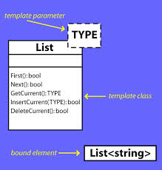
Class Templates
The template concept can also be applied to classes
Sometimes several semantically similar classes are needed where data types vary over classes
Similar data structures, member function specifications, and implementation algorithms
Are generally used for data storage (container) classes
Stacks, queues, link lists, etc.

Slide 14

Class Templates vs Function Templates
Similar syntax used for class templates as for function template
Class templates differ from function templates in the way they are instantiated
An actual function (code is generated) is created when the function template is invoked (first time for a type)
Classes are instantiated by defining an object using the template argument

Slide 15

Class Templates Syntax
Syntax to create a class template
template <class typeParameter>
class className
{
class specification or class implementation using typeParameter
};
Keyword template is required
Keyword class actually means type (NOT C++ class)
typename can be used instead
typeParameter is the template argument
Represents any built-in or user data type (including C++ classes)

Slide 16

More on the Class Templates Syntax
The member functions for class templates are defined as templates themselves
The syntax for invoking member functions other than the constructor is the same
The syntax to instantiate (invoke a constructor) a class template object
classname <type> objectname;
For example: Stack<double> stack1;

Slide 17

Header File and Implementation File of a Class Template
Until now, we have placed the specification of a class and the definition of the member functions in separate files
This doesn’t work when using templates since passing parameters to a template function is done at compilation time
When working with templates, put the class specification and the function definitions in the same header file

Slide 18

Stacks
A stack is a list of homogenous elements
Addition and deletion of elements take place only at one end, called the top of the stack
In a cafeteria the second tray, in a stack of trays, can be removed only if the first tray has been removed
Stack
A data structure in which elements are added and removed from one end only
A last in first out (LIFO) data structure

Slide 19

Operations on Stacks
New items can be added to the stack
push
The top item can be removed from the stack
pop

Slide 20

Stack Operations
Stack operations
DestroyStack
isEmptyStack
isFullStack
Push
Pop

Slide 21
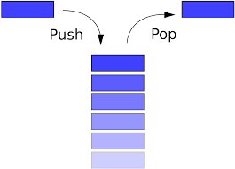
The Implementation of Stacks as Arrays
The first element of the stack can be put in the first array position, the second element of the stack in the second array slot and so on
The top of the stack is the index of the last element added to the stack
Stack elements are stored in an array and an array is a random access data structure
By definition a stack element is accessed only through the top
Not through the bottom or middle
In order to keep track of the top position of the array a another variable called top is used

Slide 22

Stack Templates
template<class Type>
class stackType
{
public:
bool isEmptyStack();
bool isFullStack();
void destroyStack();
void push(const Type& newItem);
void pop(Type& poppedItem);
stackType(int stackSize = 100);
stackType(const stackType<Type>& otherStack);
~stackType();
private:
int maxStackSize;
int top;
Type *list;
};

Slide 23

Push and Pop
template<class Type>
void stackType<Type>::push(const Type& newItem)
{
list[top] = newItem; //add newItem at the top of
//the stack
top++; //increment top
}//end push
template<class Type>
void stackType<Type>::pop(Type& poppedItem)
{
top--; //decrement top
poppedItem = list[top]; //copy the top
//element of the stack onto poppedItem
}//end pop

Slide 24

Template Client
stackType<int> stack(50);
int poppedInt;
stack.push(23);
stack.push(45);
stack.pop(poppedInt);
stack.pop(poppedInt);
stackType<double> doubleStack;
doubleStack.push(1111.1);
doubleStack.push(2222.2);
doubleStack.pop(poppeddouble);
doubleStack.pop(poppeddouble);
See template7.cpp

Slide 25
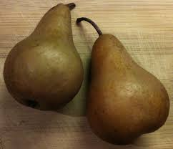
Class Templates with Two Parameters
template <class T1, class T2>
class Pair
{
public:
Pair();
Pair (T1 first_value, T2 second_value);
void set_element( T1 value1, T2 value2);
void Print( );
private:
T1 first;
T2 second;
};
To instantiate class objects
Pair<int, int> intScores;
Pair<int, char> intScores2;
See example: template8.cpp

Slide 26

Built in Class Templates - Pair
This class couples together a pair of values, which may be of different types (T1 and T2)
The individual values can be accessed through its public members first and second
template <class T1, class T2> struct pair;
http://www.cplusplus.com/reference/utility/pair/

Slide 27
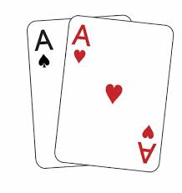
Pair Template Parameters
T1: type of member first, aliased as first_type
T2: type of member second, aliased as second_type

Slide 28
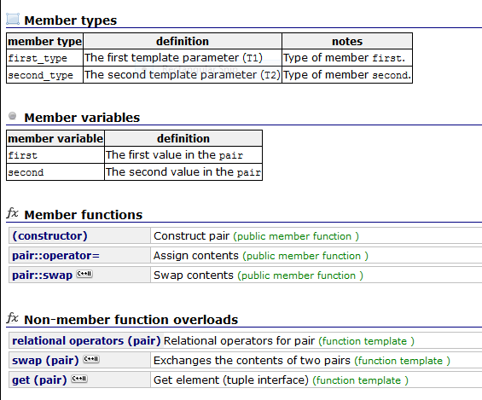
Pair Template Member Functions
See template 9

Slide 29
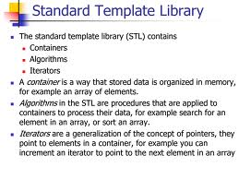
Standard Template Library (STL) “Created to Reuse Code”

Slide 30
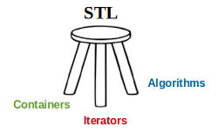
Components of the STL
Containers
Class templates
Iterators
Traverses the elements of a container
Algorithms
Manipulates data

Slide 31
Containers
Container
An object that can hold other objects as its elements
Goal:
Create a container object that automatically grows or shrinks as needed
One way to accomplish this is to use a STL container class that manages a sequence of elements
Memory is allocated and de-allocated as needed

Slide 32

More on Containers
Problem
Want to read in an unknown number of values into a buffer
Size of the buffer is unknown
One method to solve problem is to use a STL container class called a vector
A vector is similar to an array except that can automatically expand and contract as needed
The STL containers have an embedded allocator that manages memory
The new and delete operators are not used by the programmer

Slide 33
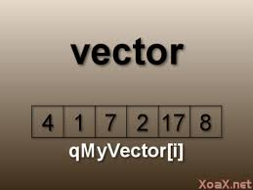
Containers Types (1)
Sequence containers
Every object has a specific position
vector
deque
list
Associative containers
Stores elements automatically sorted
Sets
Multisets
Maps
Multimaps

Slide 34
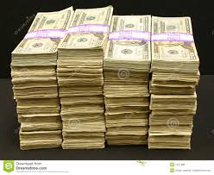
Containers Types (2)
Container adapters
Accommodates special situations
Stacks
Queues
Priority Queues

Slide 35
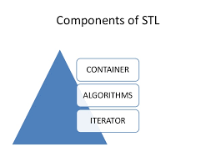
STL Template Headers
Standard Template headers
<vector> - defines a template class for implementing a container
<stack> - defines a template class for implementing a stack
<iterator> - defines a template for defining manipulating iterators
Iterator is a generalized pointer for keeping track of the beginning, ending, and other positions of a data structure

Slide 36
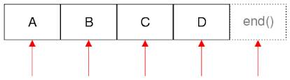
STL iterators
iterator
Is a class object that can point at an element of a container by storing its memory address
Has built in operations that can access the value stored at a location
iterator++ // move to the next element
iterator-- // move to the previous element
*iterator // access the value at the position pointed to by iterator

Slide 37
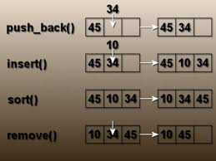
STL Vectors
Need to #include <vector>
Stores and manages its objects in a dynamic array
Must specify the type of the object
vector<int> myList;
vector<string> MyString;
Basic operations:
Item insertion
Item deletion
Traverse the elements
Vector elements can be processed just as they can in an array

Slide 38
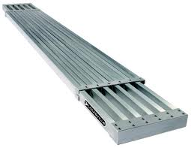
The STL Vector
Vectors are expandable
Destructor is called when the elements of a vectors are all destroyed
Constructors can being called allocating an arbitrary number of elements

Slide 39
The STL Vector
The copy constructor is invoked when during initialization
Initialization in a variable declaration
object object1=object2; // not the assignment operator
Passing an object argument by value (copy)
myFunction(object1)
Returning an object as the return value of a function (not by reference)
return (object1)

Slide 40
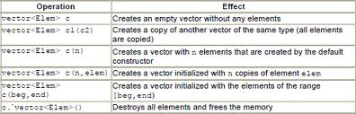
STL Constructors
vector < type> v //construct v as a vector <type> of capacity 0
vector < type> v(n) //construct v as a vector <type> of capacity n, size n, and each element is initialized to the default type value
vector < type> v(n, initialValue) // construct v as a vector <type> of capacity n, size n, and each element is initialized to initialValue

Slide 41

STL Member Functions (1)
Given vector <type> v
v.size( ) //returns the number of values v currently contains
v.empty( ) is a faster alternative to the boolean expression v.size ( ) == 0
v.capacity ( ) returns the current capacity of v
v.push_back(value) // append value at v’s end
v.reserve (n) grows v so its capacity in n (does not affect v’s size)
v.pop_back( ) // erase v’s last element

Slide 42

STL Member Functions (2)
v.front( ) // returns a reference to v’s first element
v.back( ) // returns a reference to v’s last element
v.begin( ) // returns a iterator positioned at v’s first value
v.end ( ) // returns an iterator positioned immediately after v’s last value
v.insert(pos, value ) // inserts value into v at iterator position pos
v.insert(pos, number, value ) // insert the number of value into v at iterator position pos
v.erase(pos) // erases the value in v at iterator position pos
v.erase(pos1, pos2) // erase the values in v from iterator position pos1 to pos2

Slide 43

Related Member Functions (3)
find(begin,end,value) // returns an iterator to value in the unsorted sequence, if not present return end
sort(begin,end) // sorts the sequence in ascending order
random_shuffle(begin,end) // shuffles the values in the sequence randomly
The subscript operator, [ ], does not update v’s size or capacity
The push_back ( ) method should be used when adding values to v
The push_back ( ) method updates the iterator returned by the end ( ) method
The subscript operator should only be used to access or change a value

Slide 44
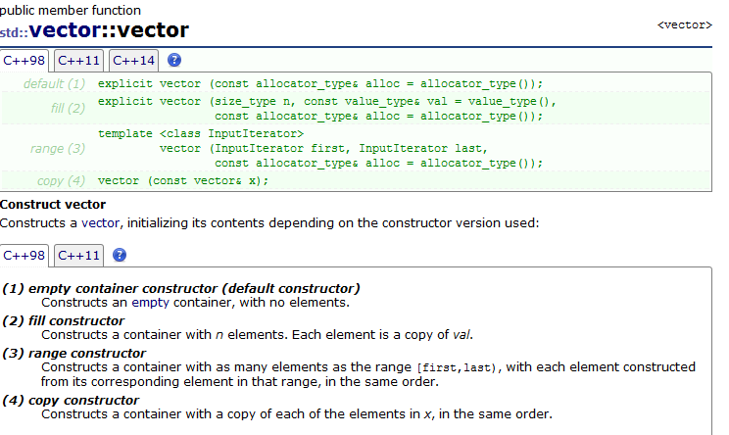
The STL Vector Web Site
For all the vector constructors and methods
http://www.cplusplus.com/reference/vector/vector/

Slide 45
STL Operators
v1 | 1 | 1
v2 | 1 | 1 | 1
v3 | 1 | 1 | 1
v4 | 1 | 2 | 0
v[i] // accesses the element whose index is I
v1 = v2 // assigns a copy of v2 to v1
v1 == v2 // returns true if and only if v1 has the same values as v2, in the same order
v1 < v2 // returns true if and only if v1 is lexicographically less than v2
v1 is not equal to v2, v3 is not equal v4
v1 is less than v2, v3 is less than v4
See examples Vector1.cpp through Vector5.cpp

Slide 46
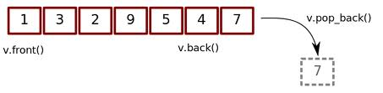
More Vector Examples
Vector 6 - comparing size, capacity and max_size
Vector 7 – inserting into a vector
Vector 8 - rbegin/rend
Vector 9 - erasing from vector
Vector 10 - copy algorithm example
Vector 11 - Inheritance
Vector 12 – Inheritance
Vector 13 - find

Slide 47

STL Template Library
The STL can be used to support stacks
See example stack1.cpp

Slide 48
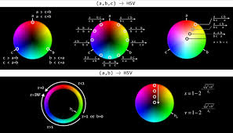
Built in Class Templates – Tuples
Tuples are objects that pack elements of (possibly) different types together in a single object, just like pair objects do for pairs of elements, but generalized for any number of elements
Capable to hold a collection of elements
Each element can be of a different type
http://www.cplusplus.com/reference/tuple/tuple/
See example tuple1.cpp
In C++ 11

Slide 49
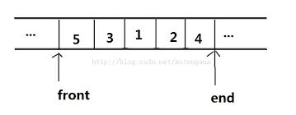
STL deque
Deque
Double-ended queue
Can expand in either direction
Elements can be inserted at both ends and in the middle
Implemented using dynamic arrays
Must use #include <deque>

Slide 50
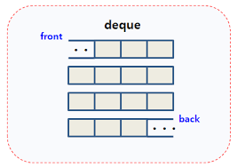
The STL Deque Web Site
For all the deque constructors and methods
http://www.cplusplus.com/reference/deque/deque/deque/

Slide 51
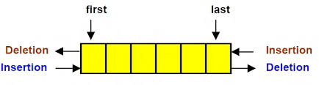
Deque Examples
Deque 1 - deque
Deque 2 – deque begin
Deque 3 - inserting into a deque

Slide 52
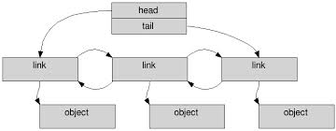
STL list
Sequence containers that allow constant time insert and erase operations anywhere within the sequence, and iteration in both directions
Implemented as doubly linked lists
Every element in a list points to immediate predecessor and immediate successor
Except the first and last element
The main drawback of lists compared to these other sequence containers is that they lack direct access to the elements by their position
For example, to access the sixth element in a list, one has to iterate from a known position (like the beginning or the end) to that position

Slide 53
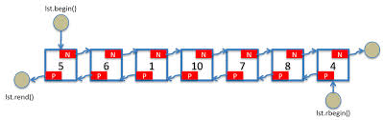
The STL List Web Site
For all the list constructors and methods
http://www.cplusplus.com/reference/list/list/list/

Slide 54
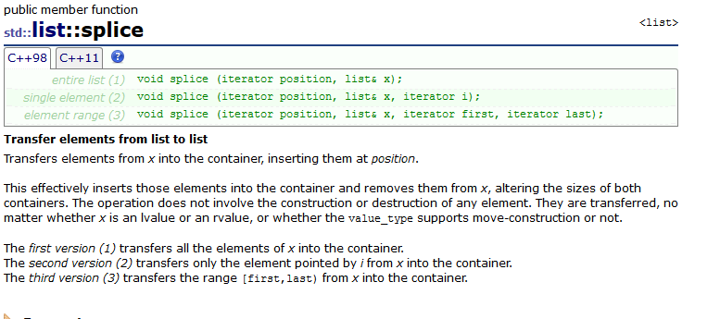
List Examples
LIST 1 - iterators
LIST 2 – iterators
LIST 3 - splicing lists

Slide 55
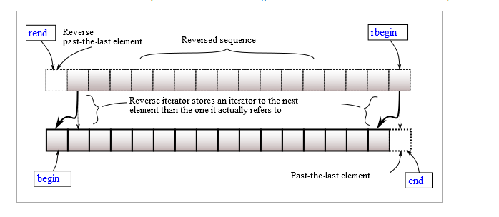
typedef reverse_iterator
Every container also contains the typedef reverse_iterator
See REVERSE1.cpp example

Slide 56

Algorithms
Generic algorithms common to all containers are contained in the header file algorithm

Slide 57
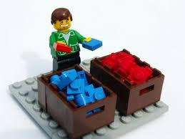
Common Operations
Operations such as clear, sort, and merge are common to all containers
Provided in <#algorithms>
http://www.cplusplus.com/reference/algorithm/

Slide 58
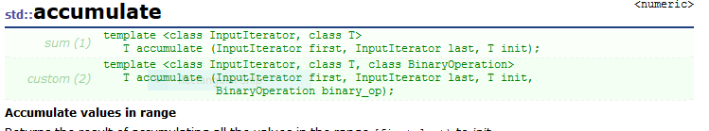
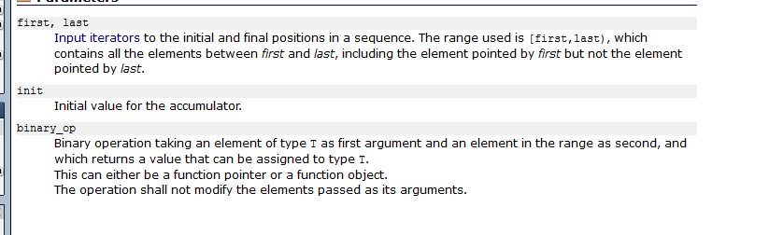
Algorithm Examples
ALGORITHM 1 – sort
ALGORITHM 2 – count_if
ALGORITHM 3 – accumulate

